Slide 1
Parasite Egg Classification and Identification
Richard Charles, Jonathan Olavarria, Nat Koonmee

Slide 2
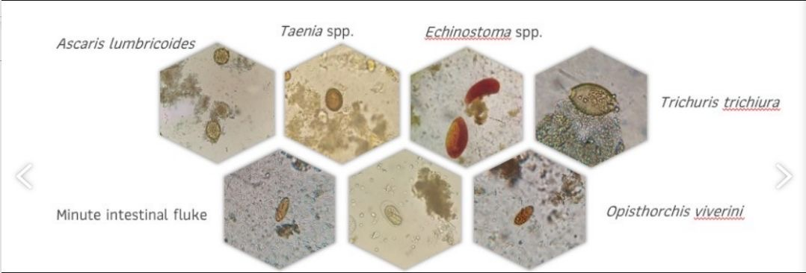
Introduction
We wanted to do image classification
CIFAR-10
Had a connection with colleague in Thailand
Dataset from Srinagarind Hospital
New Task: Try to classify images of parasite egg species

Slide 3
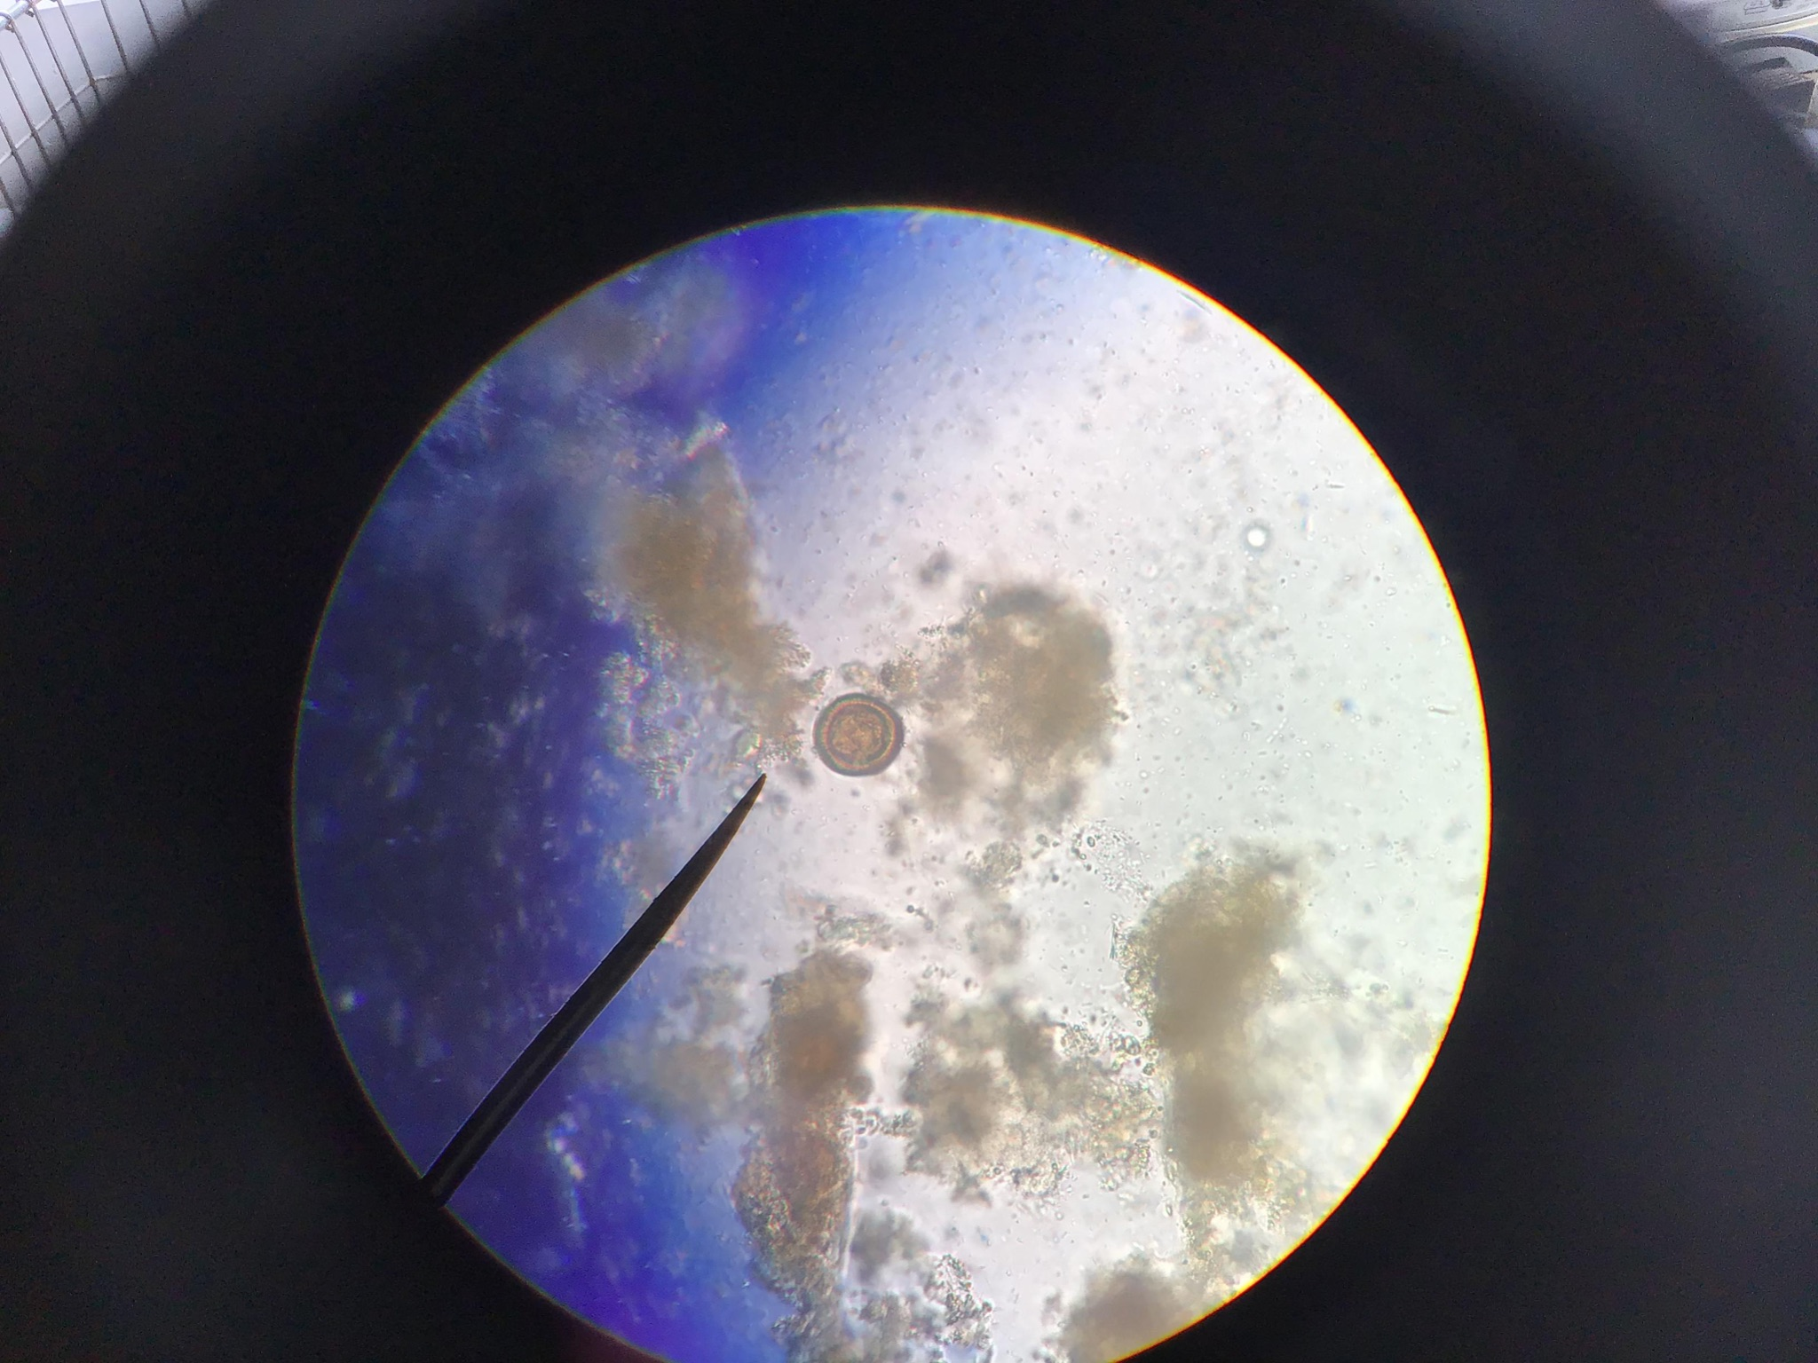
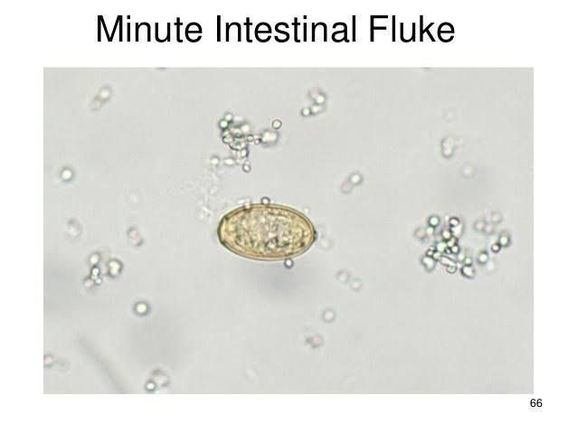
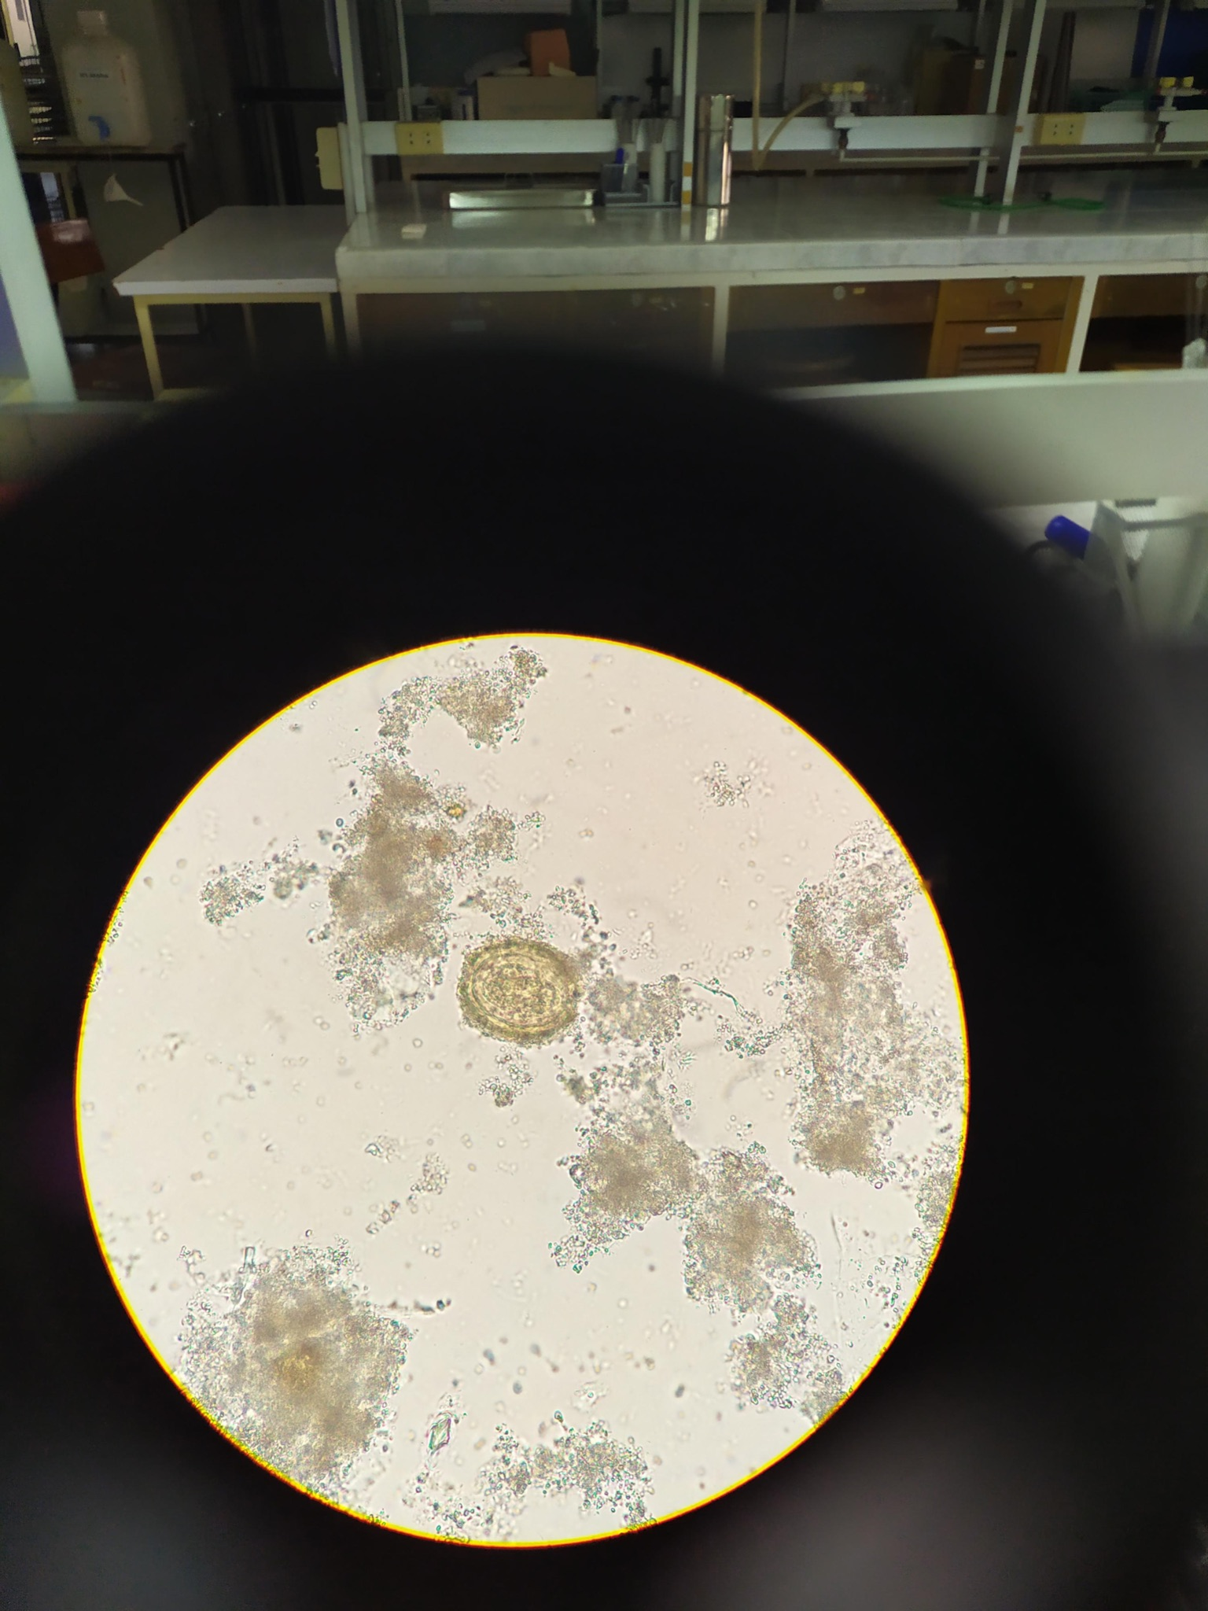
The dataset
Dataset from Srinagarind Hospital
Made up of test and training set of parasite egg images
The files were somewhat detailed so we knew that we would eventually need to make them smaller
Data was initially quite messy

Slide 4
Data Problems:
The files were somewhat detailed so we knew that we would eventually need to make them smaller
Big question was finding the optimal file size that also allowed for the model to be accurate
We would need to find a way to get rid of unusable images
Also need to shrink the vignette around a lot of the images

Slide 5
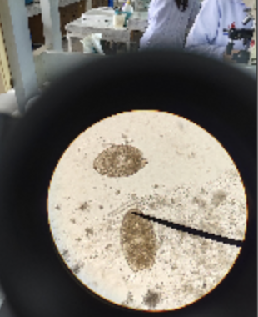
Data Cleaning
Typical image in our dataset:
Not centered.
Background of lab visible.
Some pictures were completely unrelated to project.
In order to solve these problems we decided to write a function in python that automates the cropping process.

Slide 6
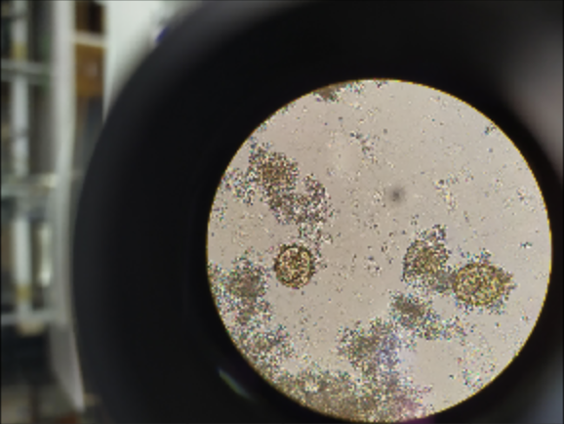
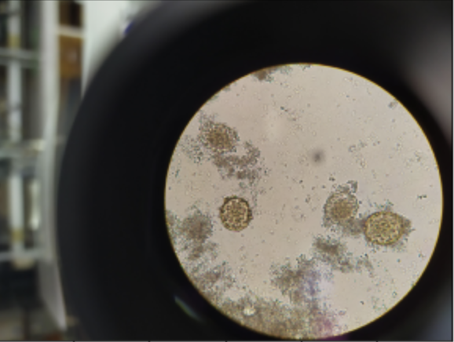
Canny Edge Detection
Noise Reduction: The edge detection calculations are highly sensitive to noise so a gaussian blur is applied to smooth the image.

Slide 7
Canny Edge Detection
2. Gradient Calculation: Detects the edge intensity and direction by calculating the gradient of the image.
3. Non-maximum suppression: Thins out edges by detecting pixels with maximum intensity in edge direction.

Slide 8
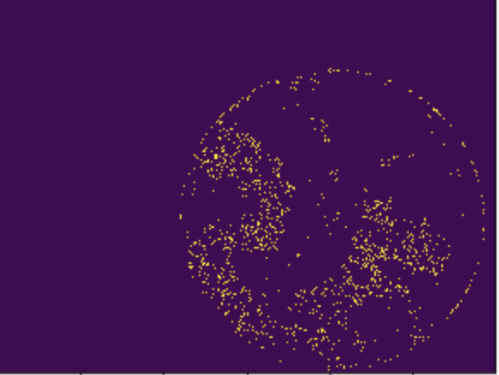
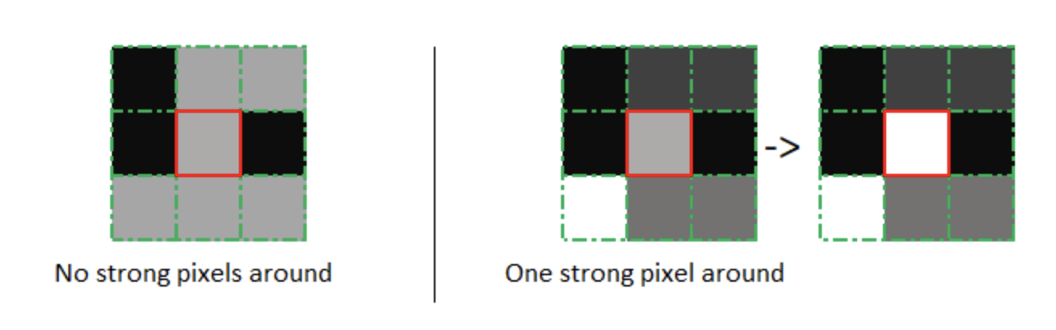
Canny Edge detection
4. Double threshold: Intensifies edges by classifying 3 kinds of pixels: strong, weak, and non-relevant. Non-relevant pixels are discarded.
5. Edge Detection by Hysteresis: Intensifies by transforming weak pixels into strong ones if at least on pixel around the pixel being processed is strong.
Edge tracking by Hysteresis Visualization (Towards Data Science)

Slide 9
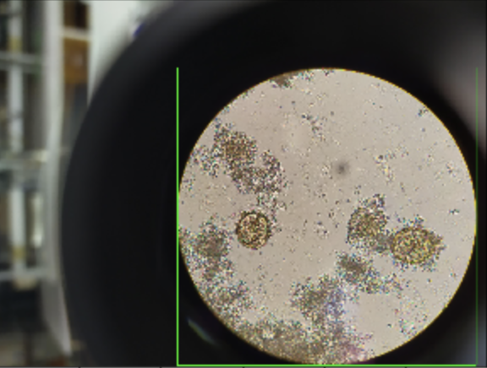
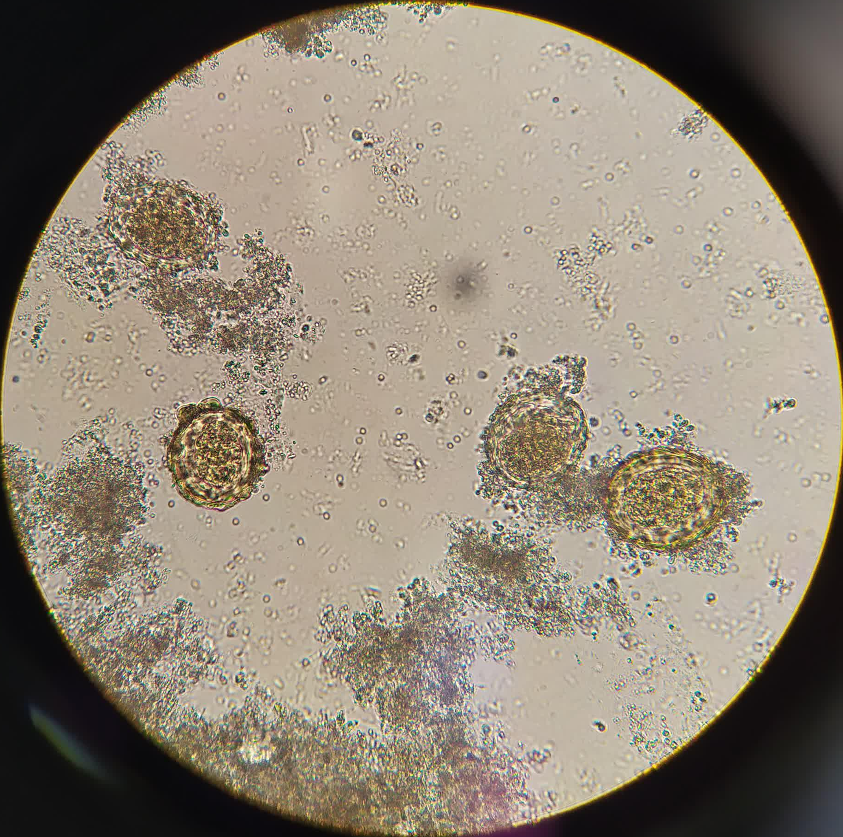
Cropping
A rectangular border was created that contained all the detected edges within the images.
Images were then cropped according to the boundaries of the rectangular border.

Slide 10
Models

Slide 11
Cifar-10
Parasite Eggs
Parasite Eggs
Parasite Eggs
Parasite Eggs
Layers
Layers from
Cifar-10
Layers
& Cropping
Layers
& Cropping
& Weight
Layers
& Weight
Accuracy : TRAIN
93%
100%
100%
100%
100%
Accuracy : TEST
82%
50%
46%
53%
68%

Slide 12
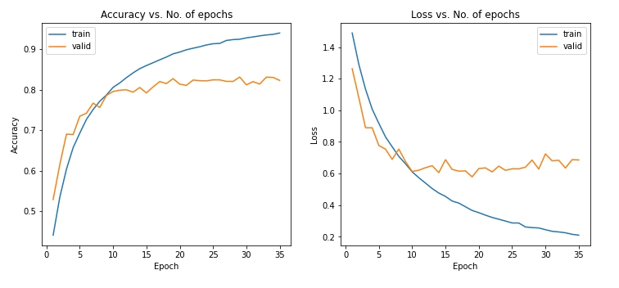
Cifar-10
Layers
Accuracy : TRAIN
93%
Accuracy : TEST
82%

Slide 13
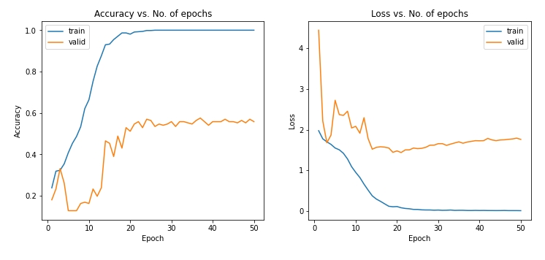
Parasite Eggs
Layers from
Cifar-10
Accuracy : TRAIN
100%
Accuracy : TEST
50%

Slide 14
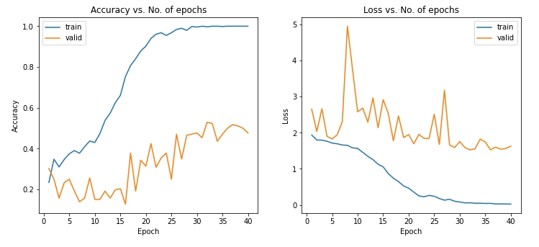
Parasite Eggs
Layers
& Cropping
Accuracy : TRAIN
100%
Accuracy : TEST
46%

Slide 15
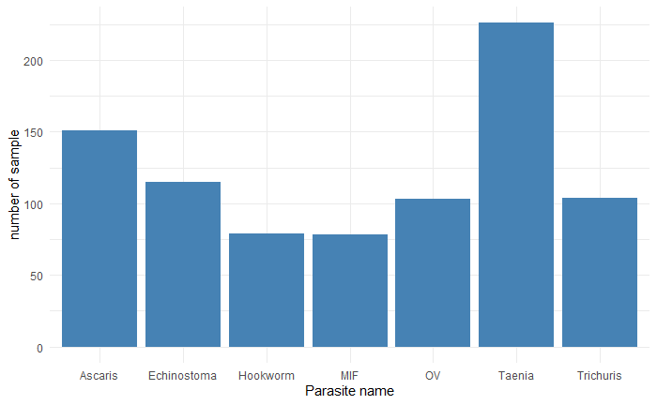

Slide 16
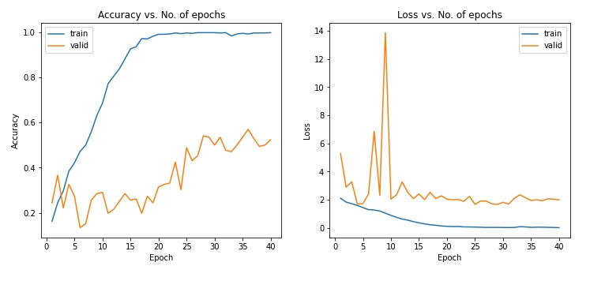
Parasite Eggs
Layers
& Cropping
& Weight
Accuracy : TRAIN
93%
100%
100%
100%
Accuracy : TEST
82%
50%
49%
53%

Slide 17
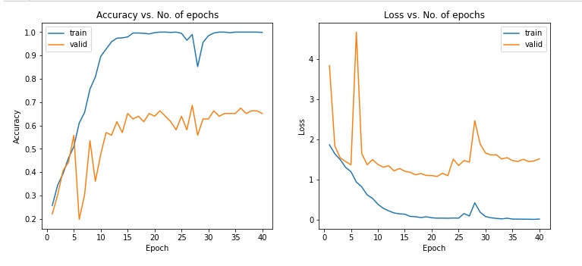

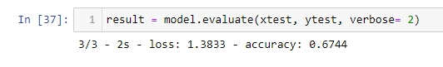
Parasite Eggs
Layers
& Weight
Accuracy : TRAIN
100%
Accuracy : TEST
68%

Slide 18
Conclusion
The accuracy of the model ended up being closer to 68%
Overfitting still seems to be a problem in training
Cropping algorithm did not end up making a huge difference in model accuracy
In the future:
We would try to get the cropping algorithm to account for image scaling
We would run the model with higher resolution images
We would add image detection to crop only the picture of the parasite egg
Try to obtain larger training set.

Slide 19
Works Cited
Keras Team. “Keras Documentation: Introduction to Keras for Engineers.” Keras, https://keras.io/getting_started/intro_to_keras_for_engineers/.
Krizhevsky, Alex. “The CIFAR-10 Dataset.” CIFAR-10 and CIFAR-100 Datasets, https://www.cs.toronto.edu/~kriz/cifar.html.
Sahir, Sofiane. “Canny Edge Detection Step by Step in Python - Computer Vision” Towards Data Science, https://towardsdatascience.com/canny-edge-detection-step-b y-step-in-python-computer-vision-b49c3a2d8123
Tensorflow Core.“Making New Layers and Models via Subclassing : Tensorflow Core.” TensorFlow, https://www.tensorflow.org/guide/keras/custom_layers_and_models.
Thailand Srinagarind hospital Laboratory (Names Confidential)
“What Is Computer Vision?” IBM, https://www.ibm.com/topics/computer-vision.

